Slide 1
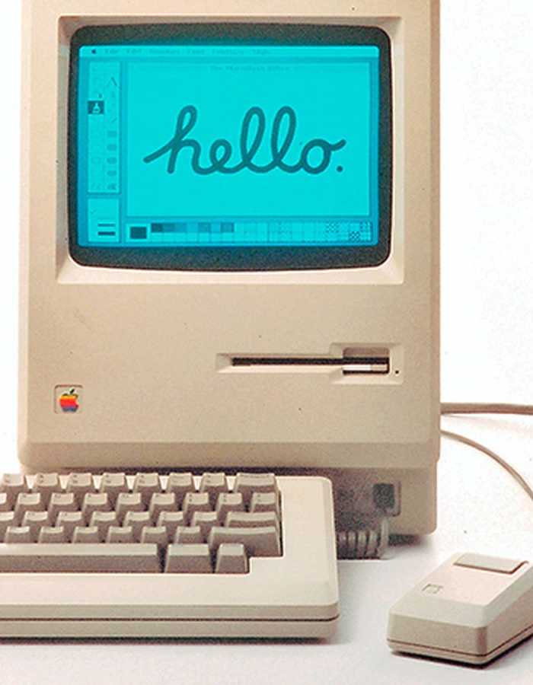
GUI implementation using Java
- Sulav Singhal – B230033CS
- Tejavath Amarsing Nayak – B230035CS
- Mohammed Arsh Thanari – B230040CS
- Yash Gupta –B230038CS

Slide 2
Overview
1
2
3
4
5
History
Implementation
Tutorial
Example Project
Recap

Slide 3
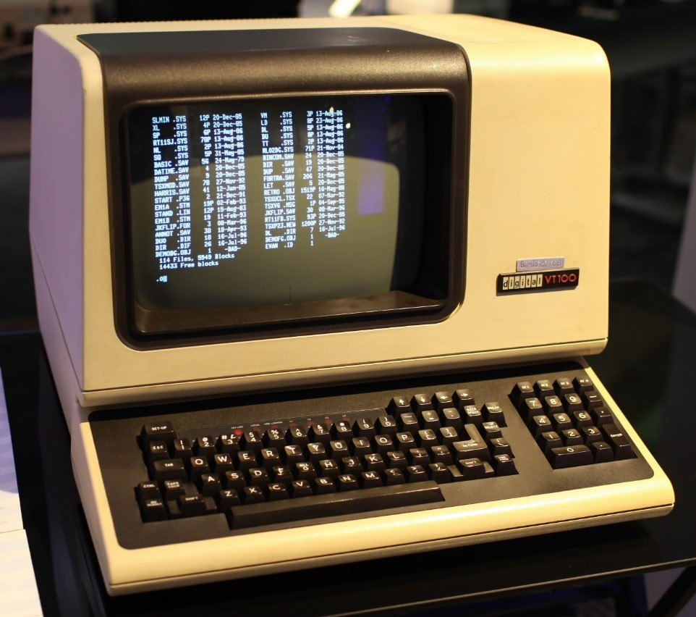
Introduction to user interfaces
What is a User Interface (UI)?
The bridge between humans and computers.
Allows users to interact with computer systems.
Types of User Interfaces:
Command-Line Interface (CLI)
Graphical User Interface (GUI)
DEC VT100

Slide 4
The Command-Line Interface (CLI)
A text-based interface that allows users to type commands to perform tasks.
Fast and efficient for expert users.
Requires memorization of commands.

Slide 5
Design is not just what it looks like and feels like. Design is how it works
“
”
Steve Jobs

Slide 6
The Graphical User Interface (GUI)
Definition: A visual-based interface with icons, buttons, windows, and menus.
Origins of GUI:
1968: Douglas Engelbart's "Mother of All Demos" introduced concepts like the mouse and window-based interfaces.
1973: Xerox Alto was the first computer designed with a GUI.
1984: Apple Macintosh popularized GUI in consumer computers.
Characteristics:
User-friendly and intuitive.
Visual elements like icons and buttons make it easier to learn.

Slide 7
Advantages of GUI
Visual Feedback: Icons, buttons, and graphics help users understand available actions.
Accessibility: Touchscreen and voice support in modern GUIs.
Efficiency in Multi-tasking: Windows and taskbars allow managing multiple applications.
Intuitive Learning Curve: Easier for beginners to learn.

Slide 8
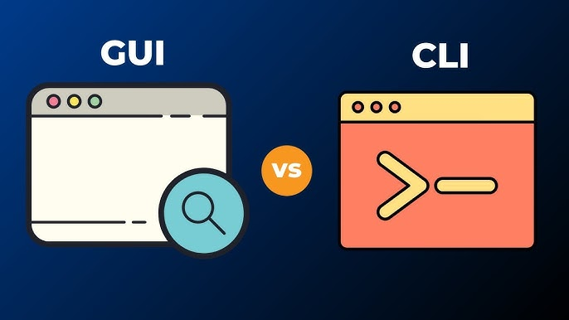

Slide 9
Feature | GUI | CLI
Learning Curve | Easy to learn | Requires memorization
Accessibility | Highly accessible with visuals | Limited to text
Speed | Slow for advanced users | High for advanced users
Resource Usage | High | Low
Customizability | Limited customization | High customization through scripting

Slide 10
Implementing GUI using Java
AWT (Abstract
Window Toolkit)
The first GUI toolkit introduced in Java.
Swing
A more powerful, flexible, and platform-independent GUI toolkit built on AWT.

Slide 11
Implementing GUI using Java
JavaFX
The latest addition, offering a modern approach for creating rich internet applications.
SWT (Standard
Widget Toolkit)
Developed by Eclipse Foundation, offers a native OS approach.

Slide 12
Pros and cons of each framework
Framework | Pros | Cons | Use Case
AWT | Fast, Simple | Limited, Platform-dependent | Small, simple apps
Swing | Customizable, Cross-platform | Slower, Complex | General desktop apps
JavaFX | Modern UI, CSS, Animation | Large footprint, Steep Learning Curve | Rich internet apps, media apps
SWT | Native look, Fast | OS-dependent, Complex | Eclipse-based, native-like apps

Slide 13
Why Swing and AWT Are Preferred
Maturity and Easy to get Started with
Cross-Platform Compatibility
Standard Library Support
Swing and AWT have been used for years and are well-supported by the Java community. And Both are very easy to get started with.
Both provide consistent UI experiences across platforms.
Both libraries are part of Java’s standard libraries and require no additional setup.

Slide 14

Conclusion
AWT and Swing offer stability and reliability for traditional GUI applications.
JavaFX is a powerful alternative for modern, media-rich applications but may not be necessary for simpler desktop programs.
Choosing the Right Tool: Each toolkit has its strengths, and the choice depends on the application's requirements for performance, look-and-feel, and functionality.

Slide 15

Thank you
- Sulav Singhal – B230033CS
- Amarsing Nayak – B230035CS
- Mohammed Arsh Thanari – B230040CS
- Yash Gupta –B230038CS

